Slide 1

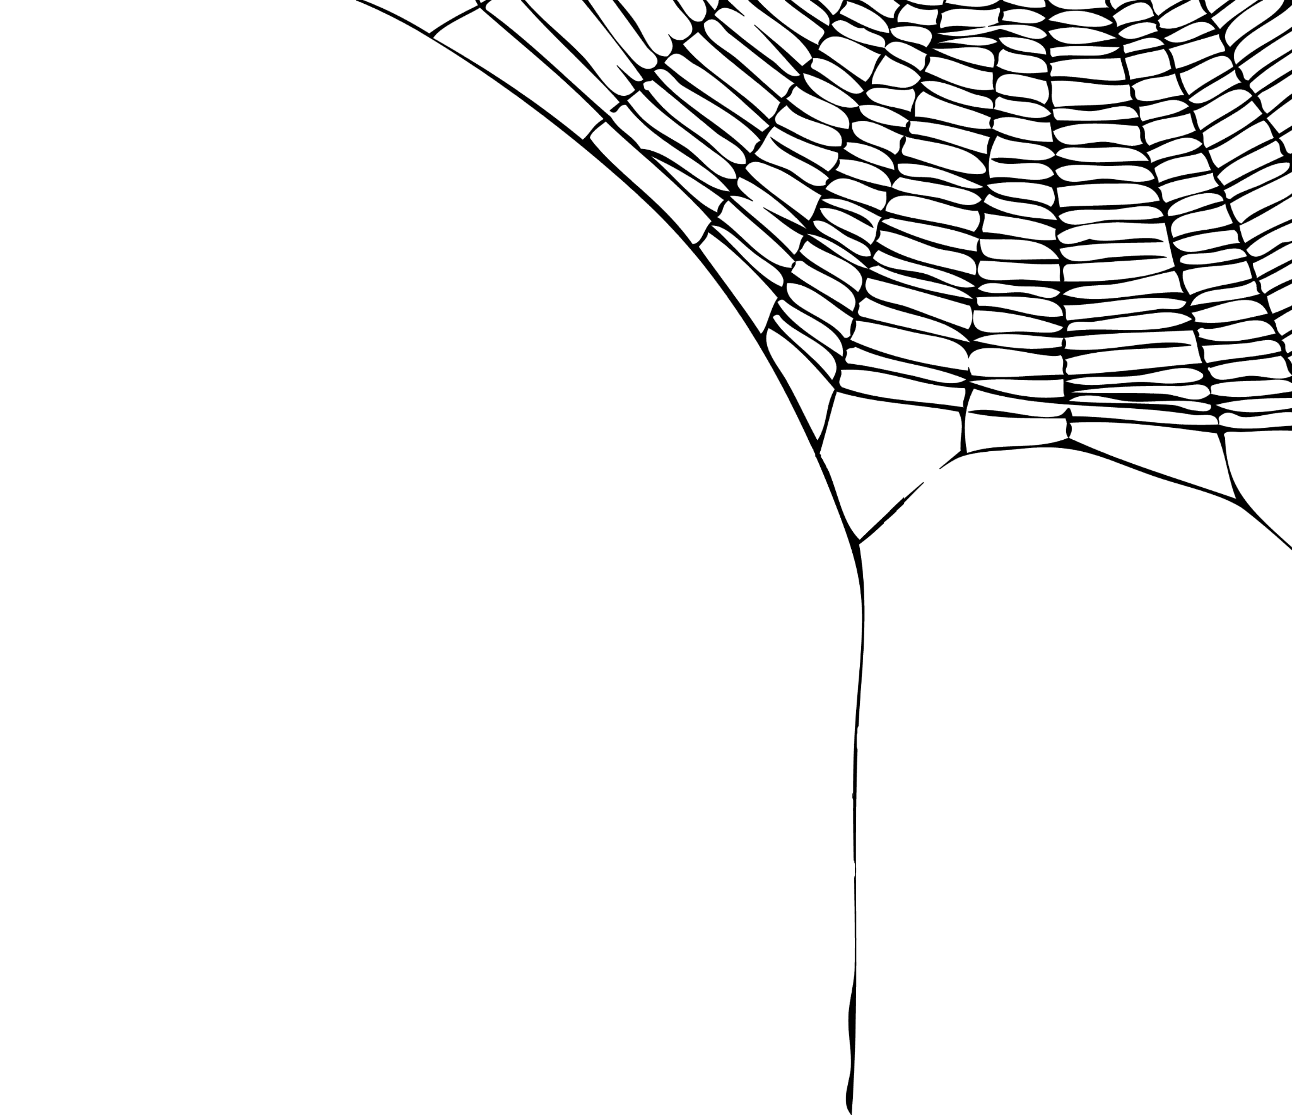

OWEEN

Slide 2
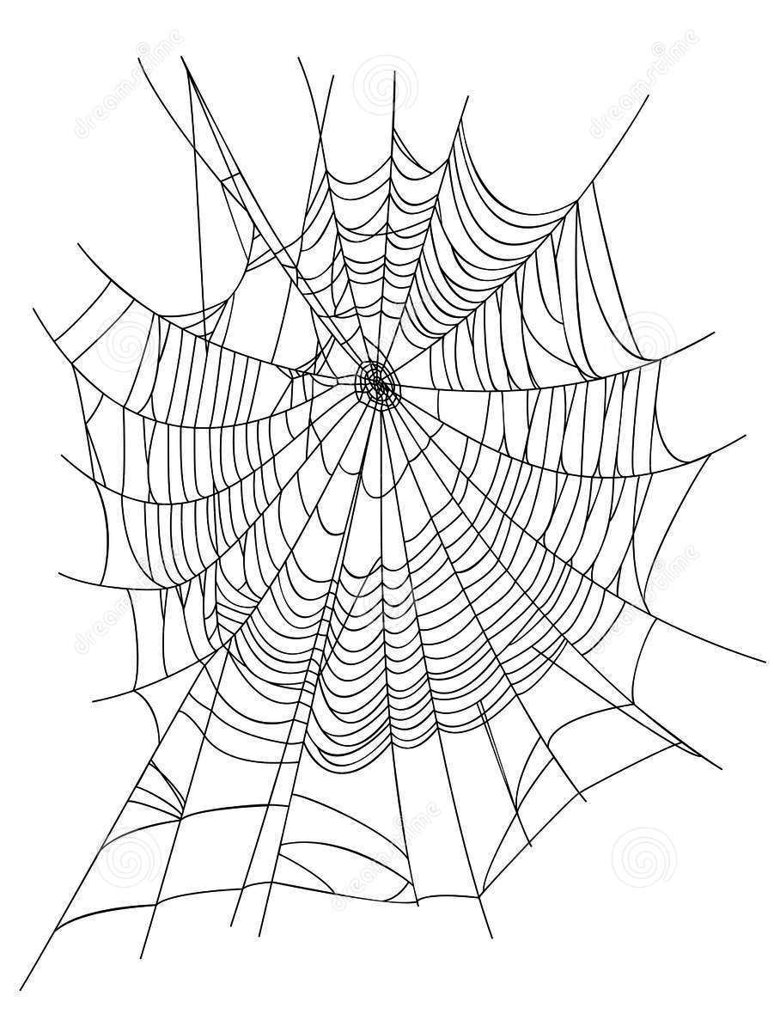
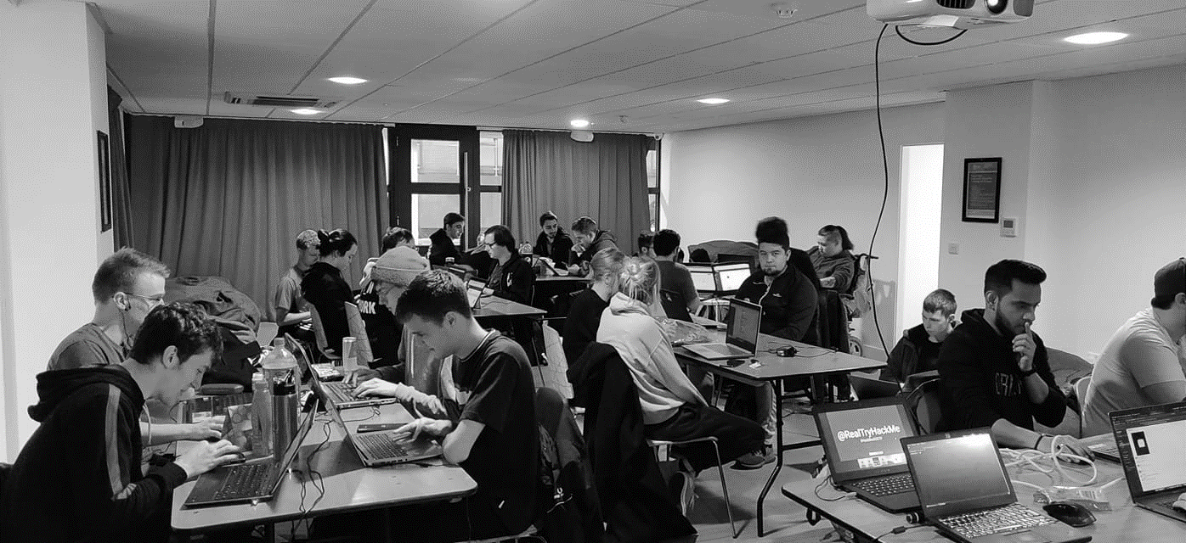



/dmuhackers
@dmuhackers
OWEEN
Introduction

Slide 3
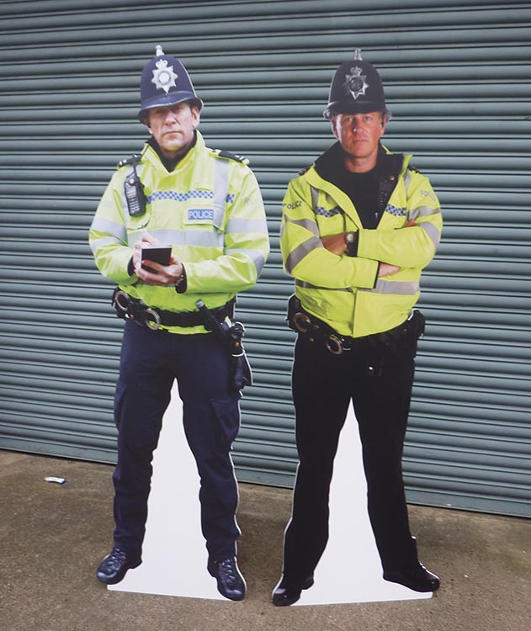





Devilish Disclaimer
Don’t do illegal shit

Slide 4
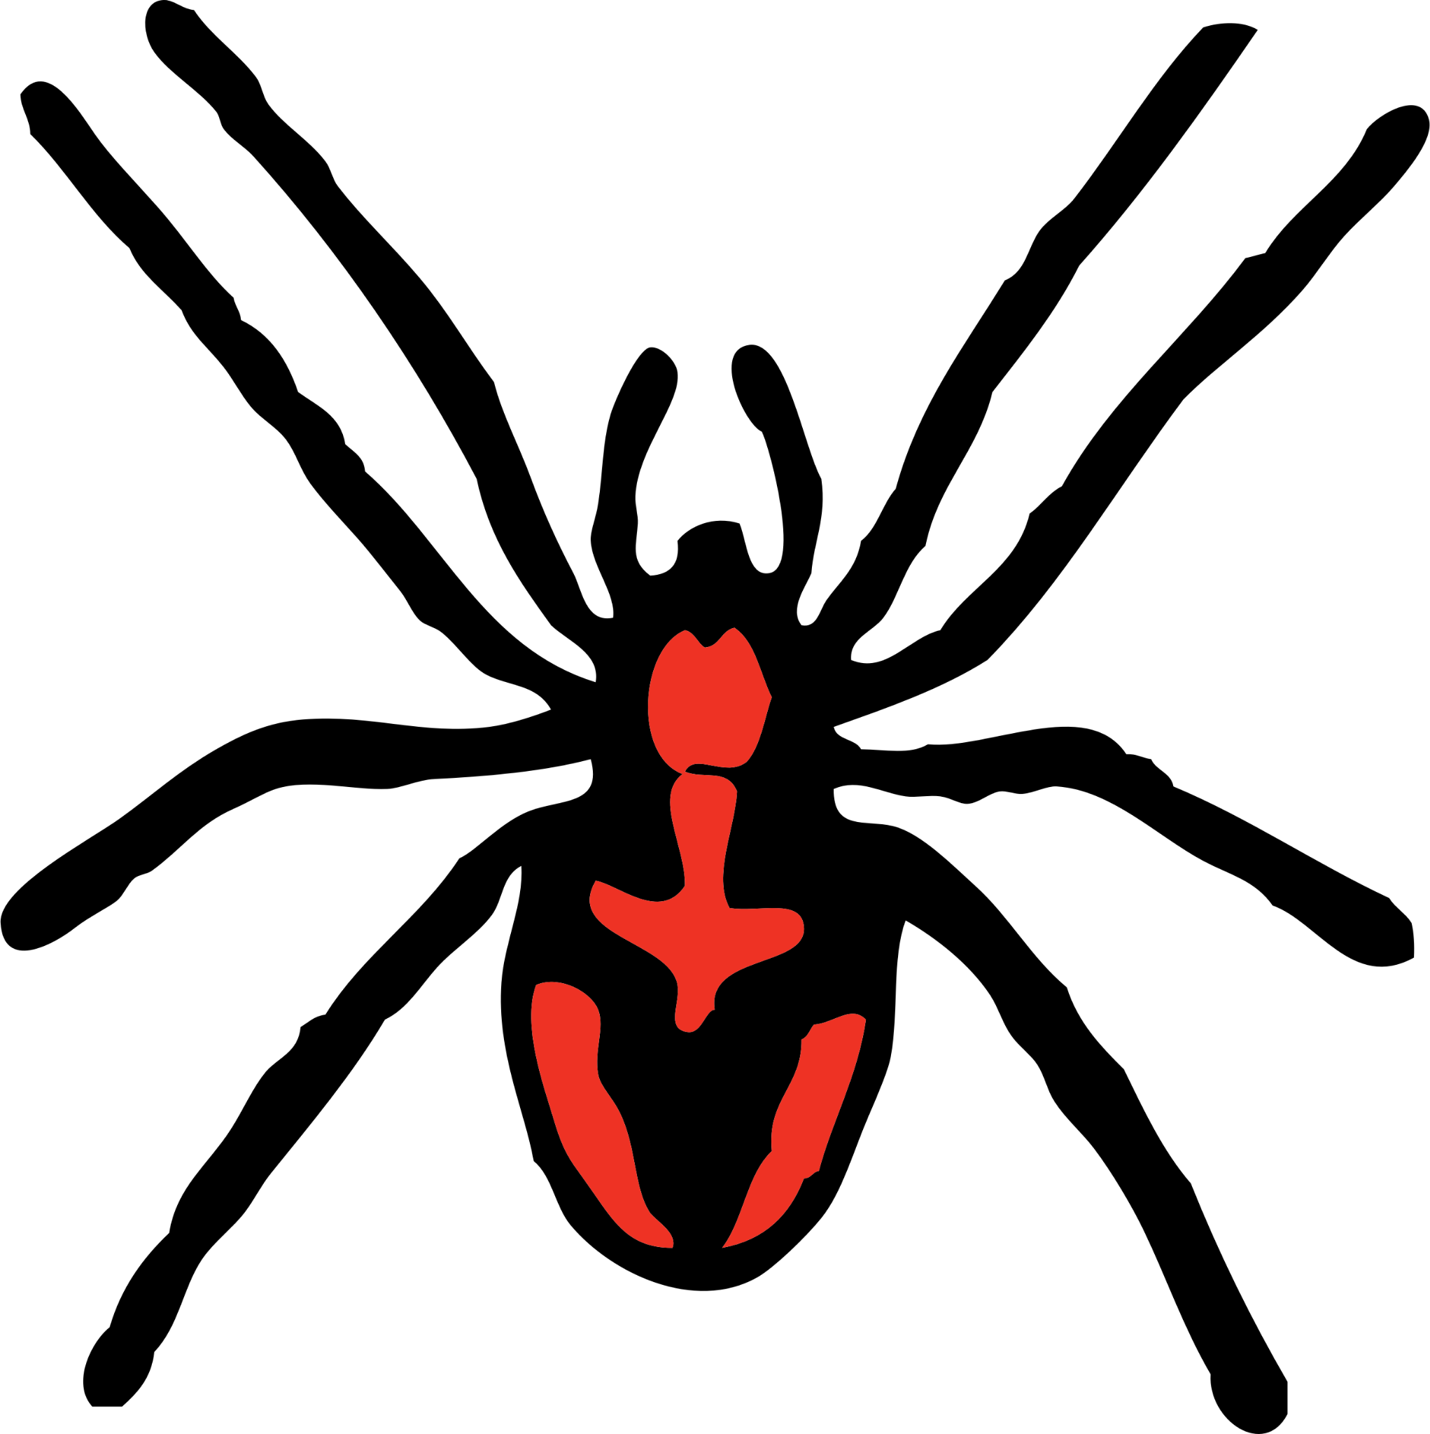
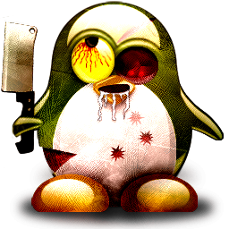
(Lily-livered)
Scary Linux
(I couldn’t find nice alliteration sorry)

Slide 5
Scary Linux
What is linux?
The Linux kernel is one of, if not the largest FOSSD projects
Built on the GNU Operating System
First released on September 17 1991
Created and developed by Linus Torvalds
Has had many contributors since
Because of the open source nature there are all sorts of distros, backend services, desktop environments.
Which allows you to build your system to look and work the way you want it

Slide 6
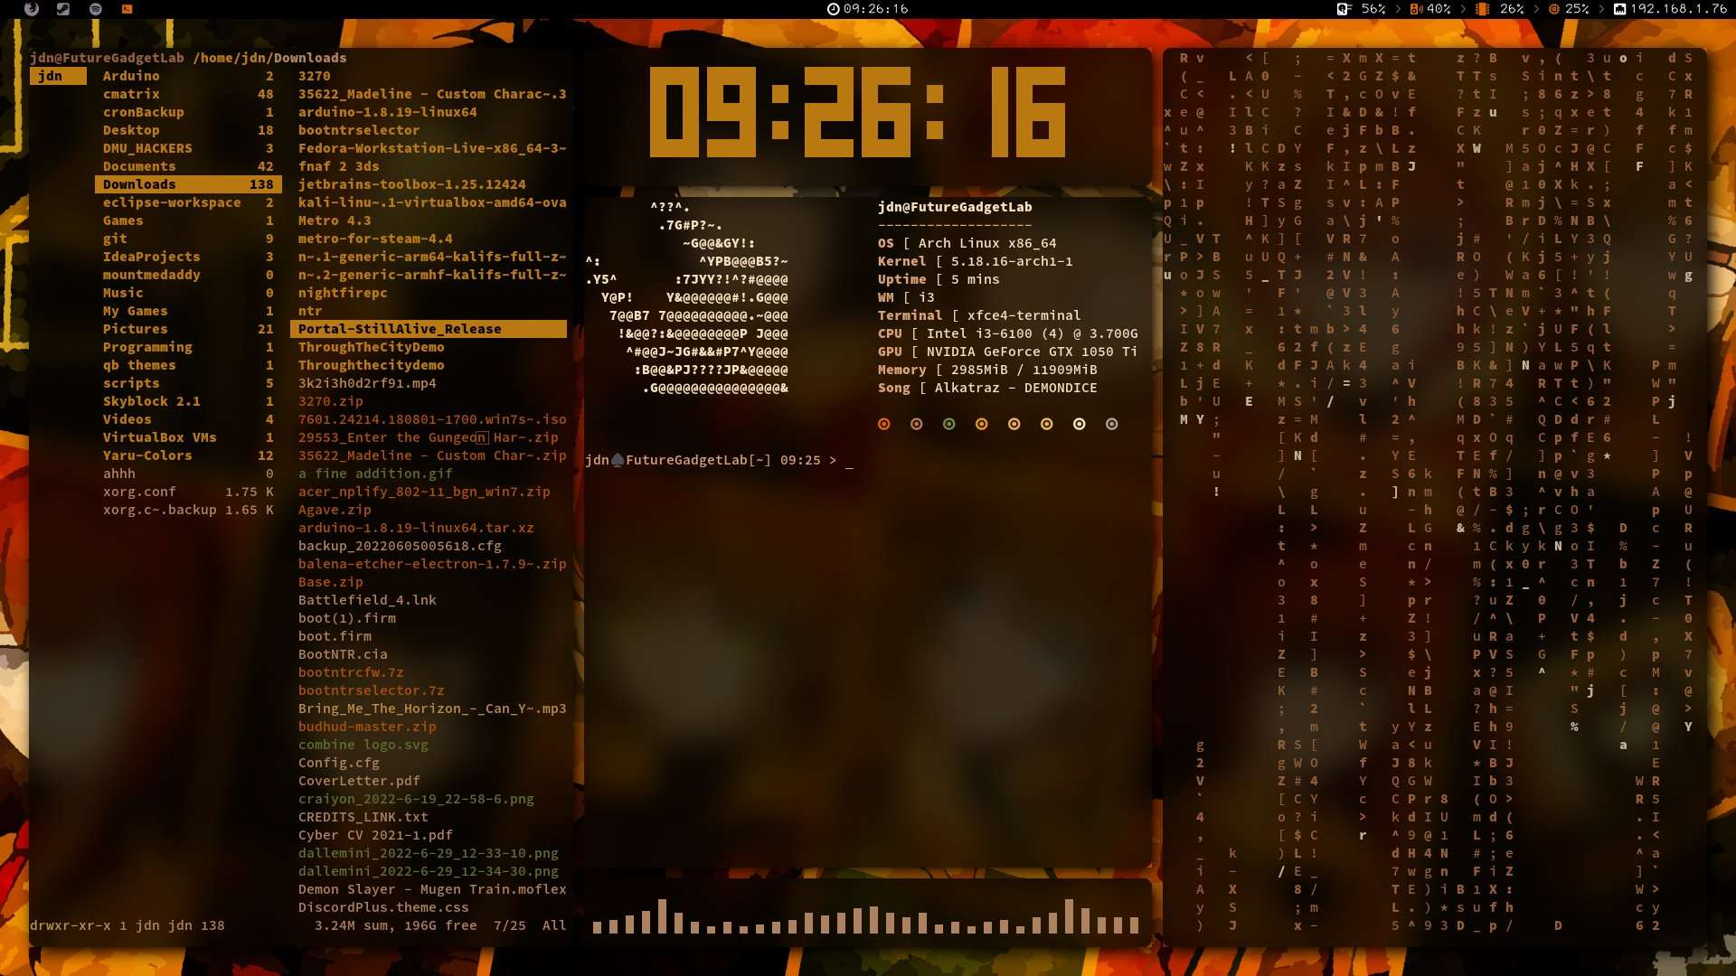
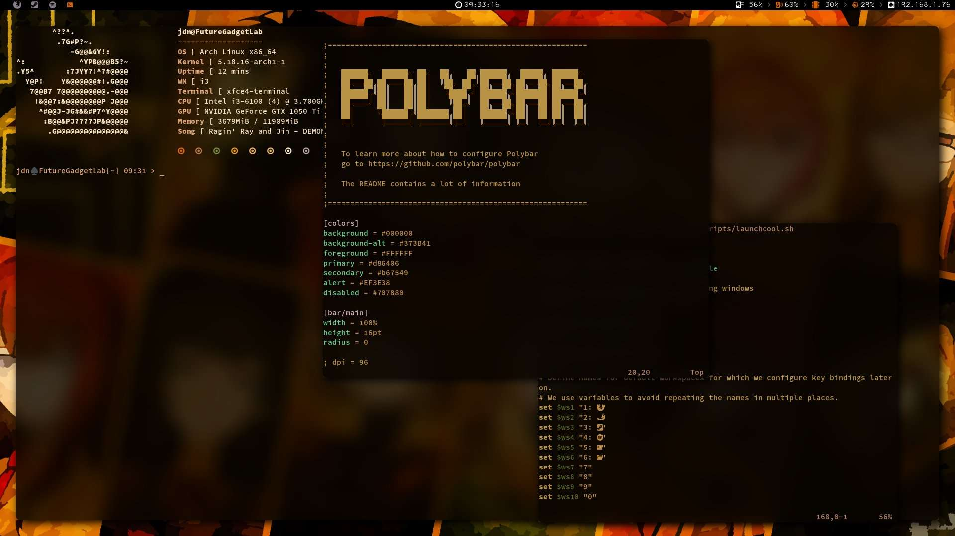

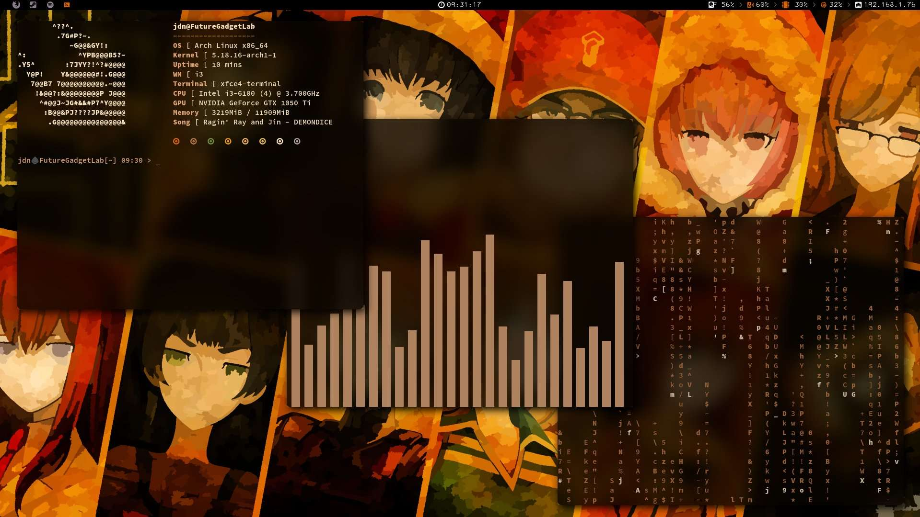
Scary Linux

Slide 7
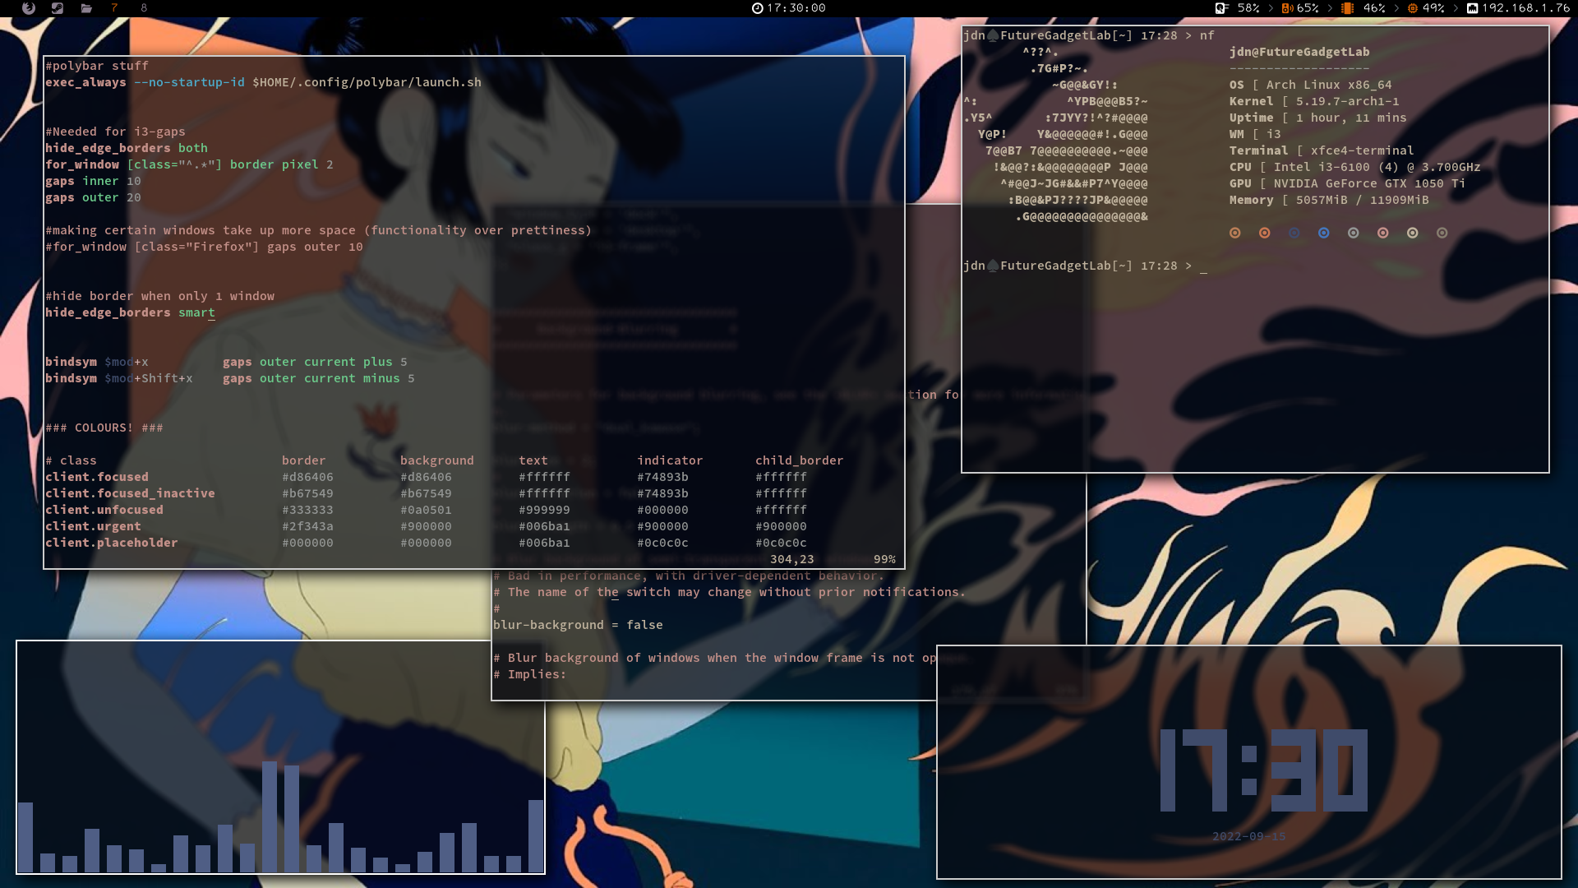
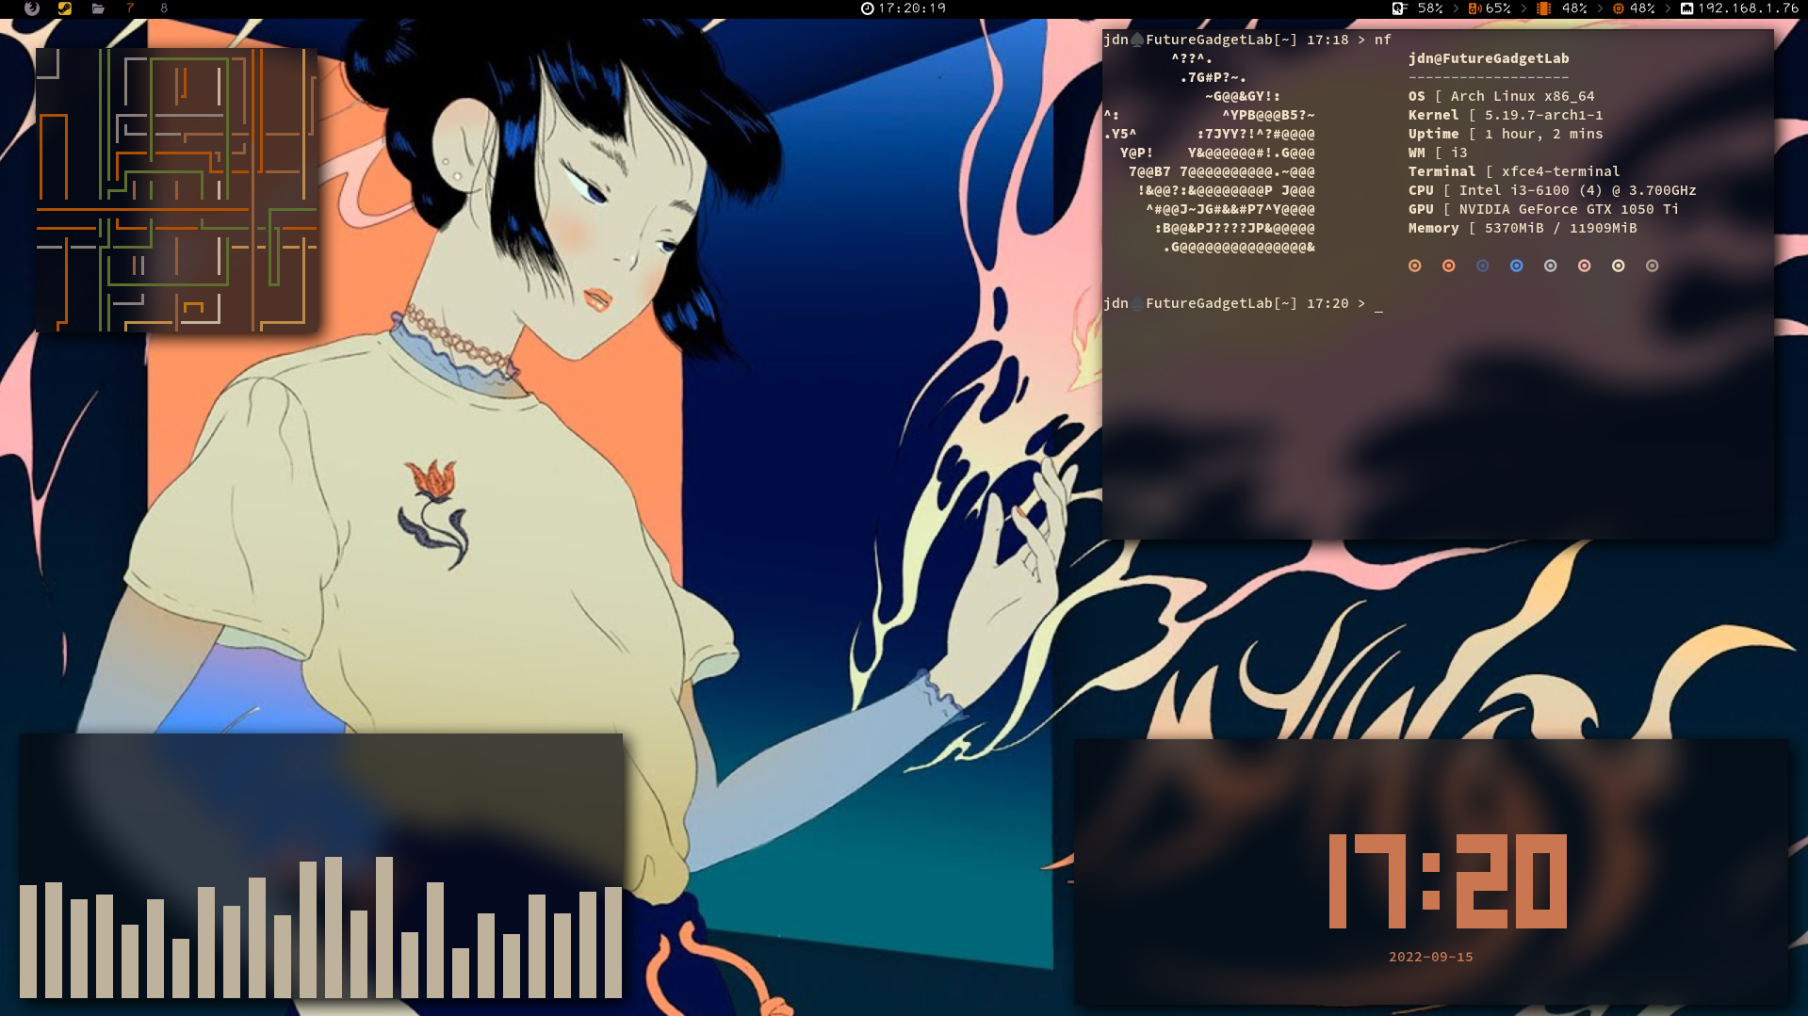
Scary Linux

Slide 8
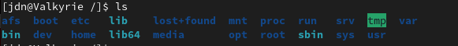
Linux Filesystem
boot - boot entry info, normally mounted to a separate boot partition
etc - system config files
mnt, media, run - drives are normally mounted here
srv - server files often default to this location (e.g ftp http)
var - it’s supposed to be where the system writes during operation
bin - binaries (executables) are stored there
usr - read only shared resources and binaries
tmp - open permissions, good for storing scripts to a compromised machine
home - where users will store their personal stuff
root - like the home directory for the root user

Slide 9
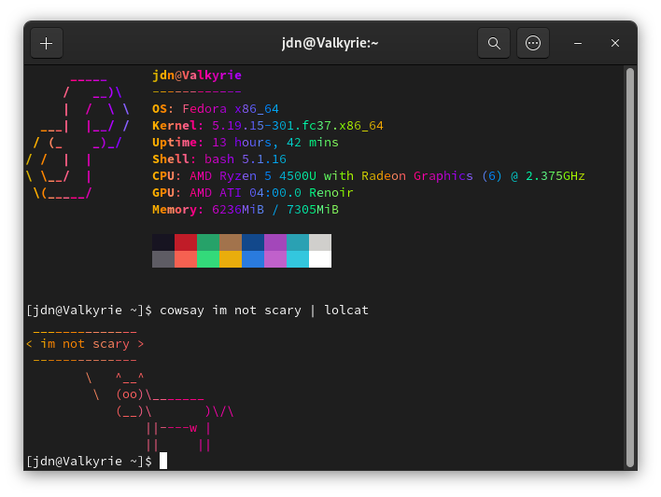
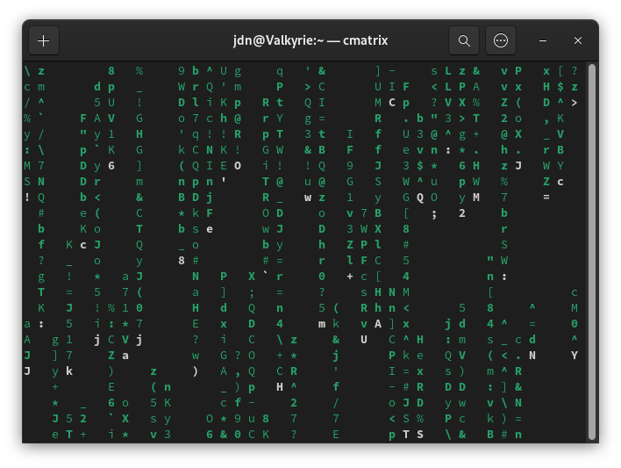
Terrifying Terminal
The terminal is your best friend when it comes to linux. And it’s not as scary as it looks.
Most commonly you will be in a bash shell
Spawned with the bash binary (/bin/bash)
Alternatives include sh, zsh, and fish
Once you get a good workflow in the
terminal you will never go back

Slide 10
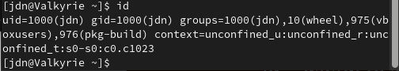
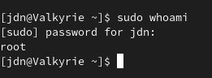
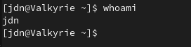
Creepy Commands
man - manuals for software
echo - output to terminal
cd - change directory
cp - copy
rm - remove/delete
ls - list
cat - output text contents of a file to terminal
mkdir - creates a directory (folder)
touch - creates an empty file
whoami - useful for when you've got a reverse shell or dumb shell
id - useful to see your user ids and groups
sudo - run a command as root

Slide 11

Some More Commands
Text Editors
vim
nano
grep - isolate a search string to the output
Find - finds things in the filesystem
names, permissions, owners
Find / -name “x” 2>/dev/null
useradd

Slide 12

Ominous Operators
&
touch file.txt & chmod 007 file.txt
< >
echo hello world > ./file.txt
nc 192.168.0.5 7777 < ./file.txt
|
cat file.txt | grep special

Slide 13
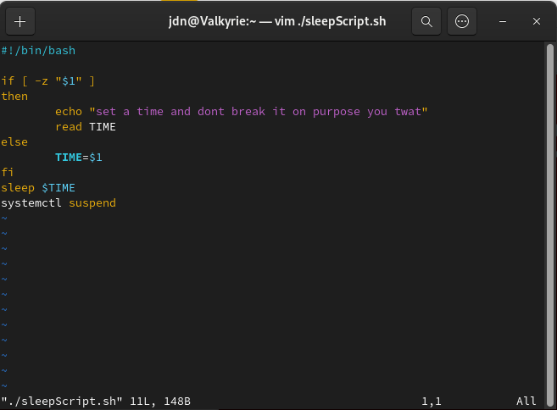
Spooky Scripting
shebang tells the system what environment to run the file in
./sleepscript.sh 30
-z means is null
“If $1 is null”
$1 is the first variable passed
If $1 is not null the variable TIME is set to $1
fi ends the if statement
Use a $ to call a variable
Wait TIME minutes
Suspend the system
Other value comparisons
-eq if [ $x -eq $y ]
if x is equal to y
-le if [ $x -le $y ]
if x is less than y
-gt if [ $x -gt $y ]
if x is greater than y

Slide 14
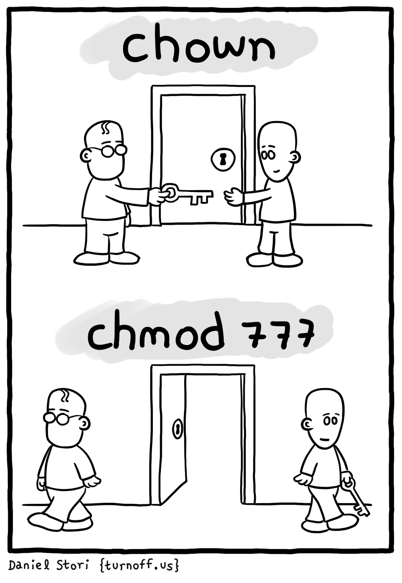
Permissions
chmod - change permissions of a file
chmod 755 sleepscript.sh
chmod +x sleepscript.sh
chown - change owner of a file
chown jdn:jdn sleepscript.sh
u |  |  | g |  |  | o
4 | 2 | 1 | 4 | 2 | 1 | 4 | 2 | 1
r | w | x | r | w | x | r | w | x

Slide 15
Useful Hacking Knowledge
Crontab - a schedule management tool that allows you to run scripts at specific times or conditions
cat /etc/crontab
crontab -l
SUID - a binary with an suid will run with the permissions of its owner
find / -perm -u=s -type f 2>/dev/null
Capabilities - allows binaries to access certain parts of the system without root
cat /proc/[id]/status | grep Cap
cat /proc/$$/status | grep Cap
This will print the capabilities of the current process

Slide 16

Practical
Create a folder called .ghost
Use ls to display that folder
Find the file rockyou.txt
Display only the lines of rockyou.txt containing the word spooky
Write this output to a file called spookyou.txt and put it into .ghost
Change the permissions of spookyou.txt such that only the owner can read it
Write and execute a bash script that takes 2 numbers and tells you if they are equal
Make this script an suid, but make sure only the owner can write to it (security)
Bonus Level
Open the terminal and enter “vim trapped”
Exit vim (closing the terminal is cheating)

